Slide 1
Protecting Data with RAID

Slide 2
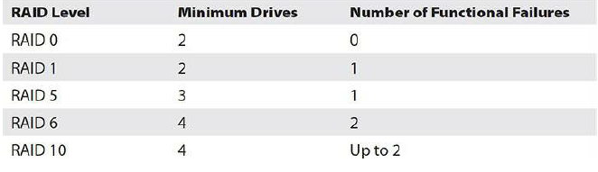
Introduction
RAID is a technology that you can use to configure locally attached storage or a storage system to provide high reliability and potentially, high performance.
RAID implements storage systems by combining multiple disks into a single logical unit called a RAID array. Depending on the configuration, a RAID array can withstand the failure of one or more of the physical hard disks contained in the array, and in addition provide higher performance than is available by using a single disk.
Source: …

Slide 3
How RAID works
RAID enables fault tolerance by using additional disks to ensure that the disk subsystem can continue to
function even if one or more disks in the subsystem fail. RAID uses two options for enabling fault tolerance:
• Disk mirroring. With disk mirroring, all of the information that is written to one disk is also written to
another disk. If one of the disks fails, the other disk is still available.
• Parity information. Parity information is used in the event of a disk failure to calculate the information
that was stored on a disk. If you use this option, the server or RAID controller calculates the parity
information for each block of data that is written to the disks, and then stores this information on
another disk or across multiple disks. If one of the disks in the RAID array fails, the server can use the
data that is still available on the functional disks along with the parity information to recreate the
data that was stored on the failed disk.
RAID subsystems also can provide potentially better performance than single disks by distributing disk
reads and writes across multiple disks. For example, when implementing disk striping, the server can read
information from all hard disks in the stripe set. When combined with multiple disk controllers, this can
provide significant improvements in disk performance.
Source: …

Slide 4
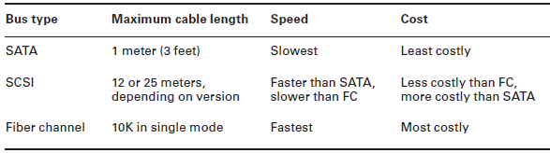
Configuration Specifications (1/2)
1. Capacity
Always keep in mind the cost in capacity of implementing each type of RAID. While there are plenty of RAID capacity calculators available on the Internet (you can access one at
www.raid-calculator.com)
2. Bus Types
The bus type of the array will have a big impact on the speed of the solution and the length of the cables involved. The three main choices are SATA, SCSI, and fiber. The types cannot
be mixed in the same array.
3. Drive RPM
Although it is possible to mix drives with different RPMs in the same pool, it is not recommended.
As a matter of fact, mixing any of the following drive specifications in the same array will result in the entire array using the least capable specification:
Slowest speed (performance)
Smallest size; for example, 750 GB + 1 TB (250 GB of the 1 TB is lost)
Smallest buffer

Slide 5
Configuration Specifications (2/2)
4. Hot-Swap Support and Ramifications
Another consideration when choosing a RAID type is hot-swap support. If you need to be able to swap out a bad drive without shutting down the server, then you require a solution that supports hot swapping. Keep in mind, however, that while you need not shut down the server, in some instances you still may need to logically disconnect the server from the bad disk and then reattach it logically when it has been replaced.
6. Array Controller
When choosing the controller you should be concerned with three issues.
Memory
RAID cards will come with memory right on the card. This memory is used to cache information, and the more you buy, the faster the performance of the array. For example, a card with 512 MB onboard would be a better choice than one with 256 MB onboard. This memory can be configured into two caches: a read cache and a write cache. A common ratio used for the two is 75:25 write:read.
Battery-Backed Cache
Another interesting aspect of the cache that comes on a RAID controller is that it is typically supported by a battery, so that if there is a loss of power, there is not a loss of the information that may be residing in the cache. This can also include changes to data that
have not yet been written to the disk as well.
Redundant Controller
To take the redundancy provided by RAID a step further, you can implement multiple RAID controllers so that you have fault tolerance not only at the disk level but at the controller level as well.
5. Hot Spare vs. Cold Spare
While hot swapping is convenient, even more convenient are hot spares. These are disks attached to the array that are not in use but are available to take the place of a bad disk
automatically. A cold spare, on the other hand, is one that is attached to the system and available but cannot replace the bad disk without administrator intervention and in some
cases a reboot.

Slide 6
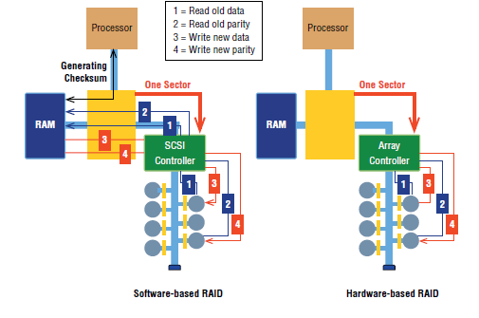
Hardware RAID vs. software RAID
Software is often used when price takes priority over performance.
Software RAID does not require special controllers; you can use the regular SATA controllers to make a software RAID array. But you do need “smart” software. The most common software implementation of RAID is the built-in RAID software that comes with Windows.
Software RAID means the operating system is in charge of all RAID functions. It works for small RAID solutions but tends to overwork your operating system easily, creating slowdowns.
Hardware is used when you need speed along with data redundancy.
Hardware RAID centers on an intelligent controller that handles all of the RAID functions. Unlike regular PATA/SATA controllers, these controllers have chips with their own processor and memory. This allows the card or dedicated box, instead of the operating system, to handle all of the work of implementing RAID.
Most traditional RAID setups in the real world are hardware-based.
Almost all of the many hardware RAID solutions provide hot-swapping—the ability to replace a bad drive without disturbing the operating system. Hotswapping is common in hardware RAID.
Hardware-based RAID is invisible to the operating system and is
configured in several ways, depending on the specific chips involved. Most RAID systems have a special configuration utility in Flash ROM that you access after CMOS but before the OS loads.
Source: …

Slide 7
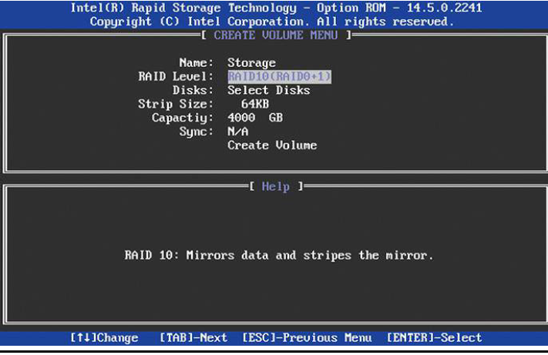
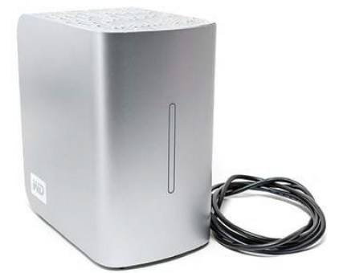
Hardware RAID vs. software RAID
RAID configuration utility - a firmware program used to configure a hardware RAID solution
Dedicated RAID Boxes
Source: …

Slide 8
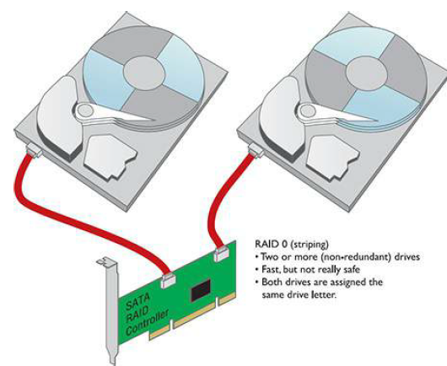
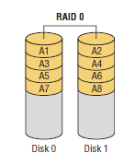
Implementing RAID
RAID 0—Disk Striping Disk striping requires at least two drives. It does not provide redundancy to data. If any one drive fails, all data is lost.
The one and only advantage of disk striping is speed—it is a fast way to
read and write to hard drives.
RAID 0

Slide 9
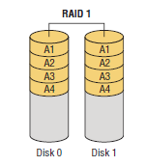
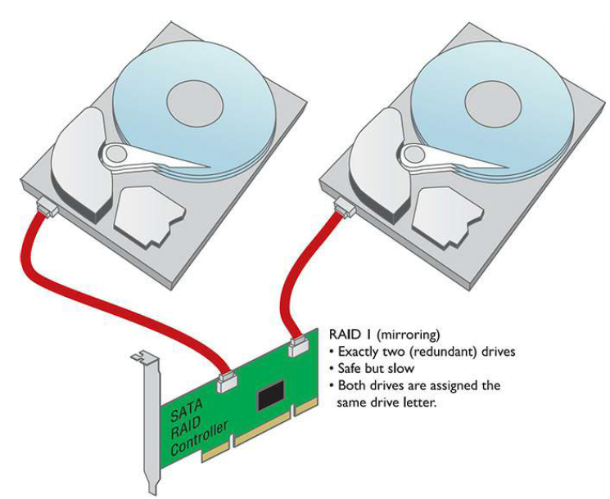
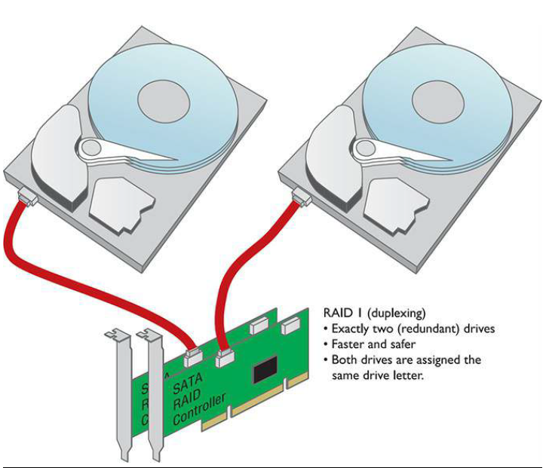
Implementing RAID
RAID 1—Disk Mirroring/Duplexing RAID 1 arrays require at least
two hard drives, although they also work with any even number of
drives. RAID 1 is the ultimate in safety, but you lose storage space
because the data is duplicated
Disk duplexing is also marginally faster than disk mirroring because one
controller does not write each piece of data twice. With two drives, each on a separate controller, the system will continue to operate even if the primary drive’s controller stops working.
Disk duplexing is also marginally faster than disk mirroring because one
controller does not write each piece of data twice
Even though duplexing is faster than mirroring, they both are slower than
the classic one-drive, one-controller setup
RAID 1 (Disk Mirroring/Duplexing)

Slide 10
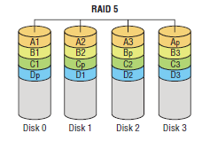
Implementing RAID
RAID 5—Disk Striping with Distributed Parity Instead of dedicated
data and parity drives, RAID 5 distributes data and parity information
evenly across all drives. This is the fastest way to provide data
redundancy. RAID 5 requires at least three drives.
RAID 5 arrays effectively use one drive’s worth of space for parity.
If, for example, you have three 2-TB drives, your total storage capacity is 4 TB. If you have four 2-TB drives, your total capacity is 6 TB.
RAID 5 (Disk Striping with Distributed Parity)

Slide 11
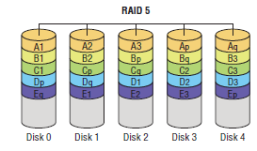
Implementing RAID
RAID 6—Disk Striping with Extra Parity If you lose a hard drive in
a RAID 5 array, your data is at great risk until you replace the bad hard
drive and rebuild the array. RAID 6 is RAID 5 with extra parity
information. RAID 6 needs at least four drives, but in exchange you
can lose up to two drives at the same time.
RAID 6 writes parity information across the drives as is done in RAID 5, but it writes two stripes, which allows the system to recover from two drive failures whereas RAID 5 cannot. As each set of parities must be calculated separately, performance is slowed during writing to the drive. The cost is higher due to the two drives dedicated to parity information.
RAID 6 uses 2/n (n = the number of drives in the array) for parity information and only 1 – (2/n) is available for data.
RAID 6 (Disk Striping with Extra Parity)

Slide 12
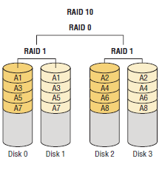
Implementing RAID
RAID 10—Nested, Striped Mirrors RAID levels have been
combined to achieve multiple benefits, including speed, capacity, and
reliability, but these benefits must be purchased at a cost, and that cost
is efficiency.
Striped sets are mirrored (a minimum of four drives, and the number of drives must be even). It provides fault tolerance and improved performance
but increases complexity.
This array will provide half of the total drive space in the array as available drive space. For example, if there are four 250 GB drives
in a RAID 10 array (for a total of 1,000 GB), the available drive space will be 500 GB.
RAID 10 – or 1+0 ((Nested, Striped Mirrors)

Slide 13
Implementing RAID
Like RAID 10, RAID 0+1 (or a “mirror of stripes”) is a nested set of arrays that works in opposite configuration from RAID 10. It takes a minimum of four drives to implement RAID 0+1.
Can tolerate the failure of two or more disks provided that all failed disks are in the same striped set.
Not commonly used.
RAID 0+1 (Nested, Mirrored Stripes)

